Slide 1
Predicting The Reviews Of Restaurant Using Natural Language Processing
Abrar Hussain (20UE1A0501)
Kavya sri (21UE5A0503)
Priyanka (20UE1A0530)
Manikanta (21UE5A0505)

Slide 2
Abstract
The most effective tool any restaurant can have is the capability to track the daily sales of their food and beverage. Currently, recommendation systems play an important role in both academia and industry.
These are very helpful to manage an overload of information. In this paper, applied NLP techniques for user reviews were used and valuable information in the reviews were analyzed. For both the customers and the owners, reviews are useful to make data-driven decisions.
We built a machine learning model with Natural Language Processing techniques which captures a user’s opinions from user’s reviews. A lot of businesses fail due to the lack of profit and a lack of proper improvement measures.
Mostly, restaurant owners face a lot of difficulties to enhance their productivity. Recommendation programs are finally being used to provide customers with a customized selection of services.

Slide 3
Existing System
Many researchers have done experiments to classify the sentiments of the customers on different datasets earlier. Like Turney (2002) used a semantic orientation algorithm to classify reviews based on the numbers of positively oriented and negatively oriented phrases in each review. Pang et al. (2002) used machine learning tools such as Naive Bayes, Maximum Entropy and Support Vector Machine (SVM) classifiers to classify movie reviews using a number of simple textual features.

Slide 4
Drawbacks
This type of classification is only done when the classifier has to work on the binary data which is not the case with Restaurant Reviews.
However, from a practical point of view perhaps the most serious problem with SVMs is the high algorithmic complexity and extensive memory requirements of the required quadratic programming in large-scale tasks.
If categorical variable has a category (in test data set), which was not observed in training data set, then model will assign a 0 (zero) probability and will be unable to make a prediction. This is often known as "Zero Frequency".

Slide 5
Proposed System
Our proposed system is to apply natural language processing techniques to classify a set of restaurant reviews based on the number of stars that each review received. We develop a maximum entropy classifier to categorize each review from 1-star to 5-stars.
We analyze how a review's conformance to a particular language model can be affected by the sentiment of the review We experiment with different linguistically motivated models of sentiment expression, again using the results to improve the performance of our classifier We examine the effects of part-of-speech tagging on our ability to predict sentiment.
We experimented with different methods of preprocessing the data. Because the reviews are unstructured in terms of user input, reviews can look like anything from a paragraph of well-formatted text to a jumble of seemingly unrelated words to a run-on sentence with no apparent regard for grammar or Punctuation.
Our initial pass over the data simply tokenized the reviews based on whitespace and treated each token as a unigram, but we were able to improve performance by removing punctuation in addition to the whitespace and converting all letters to lowercase. In this way, we treat the occurrences of "good", "Good", and "good."

Slide 6
Advantages
Good at pattern recognition problems.
Data-driven, and performance is high in many problems.
End-to-End training: little or no domain knowledge is needed in system construction.
Learn of representations: cross-modal processing is possible.
Gradient-based learning: learning algorithm is simple.
Mainly supervised learning methods.

Slide 7
System Requirments
System : Intel i3
Hard Disk : 1 TB
Monitor : 14’Colour Monitor
Mouse : Optical Mouse
Ram : 4GB

Slide 8
Software Requirements
Operating System : Windows 8/10/11
Coding Language : Python 3.7
Front-End : Tkinter API
IDE Tool : PyCharm Community Edition
Designing : Pandas, scikit-learn, matplotlib, numpy.
Dataset : Restaurant Reviews Dataset

Slide 9
Modules
NLTK
Pandas
Tkinter
Vectorization
Process Description

Slide 10
Algorithm
Dataset Collection
Data Preprocessing
Feature Extraction
Feature Classification
Prediction Modeling
Performance Metrices
Performance Analysis

Slide 11
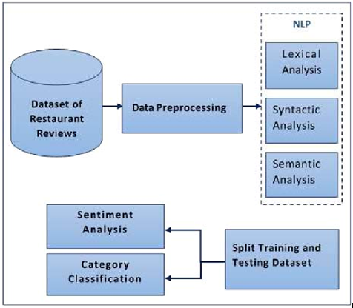
Architecture

Slide 12
System Testing
The purpose of testing is to discover errors. Testing is the process of trying to discover every conceivable fault or weakness in a work product. It provides a way to check the functionality of components, sub assemblies, assemblies and/or a finished product It is the process of exercising software with the intent of ensuring that the
Software system meets its requirements and user expectations and does not fail in an unacceptable manner. There are various types of test. Each test type addresses a specific testing requirement.

Slide 13
Conclusion
Learning about the customer is the first and foremost priority for any type of business to be successful and have a happy customer. The same is the case with restaurants. Restaurants who need to know their customer-base can greatly benefit from this project. We proposed machine learning NLP techniques for classification of restaurant reviews . We apply stemming for efficiency.
The motive of the model is to detect the sentiments/opinions of the reviews. The developed model has an accuracy of 97.67% and it successfully identifies the sentiments of the reviews. The model was tested with a data set that contained reviews from customers and it detected the sentiments accurately. We can conclude that the intention of this project was fulfilled and the model can be used to identify the sentiments of the reviews.

